Slide 1
Journey Scrapbook
Week 1
Yuvraj Singh
Emp ID - 655486

Slide 2
18th Aug 2023
Introduction to Business Analysis
SDLC Model
Requirement Analysis
Use case Diagram
Management Techniques
Waterfall Model
Agile and Scrum
Team activity - Roleplay

Slide 3
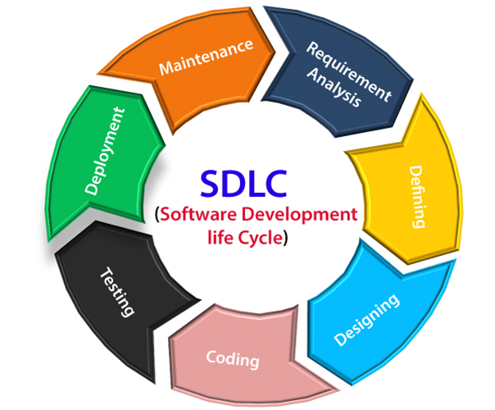
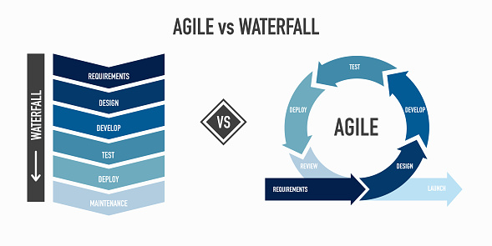

Slide 4
21st Aug 2023
Epic, User Story, Task, Sub Task
Story point Estimation
Definition of Ready
Definition of Done
Scrum and Kanban Board
Project Failures
Sprint Backlog
Values and Principles of agile

Slide 5
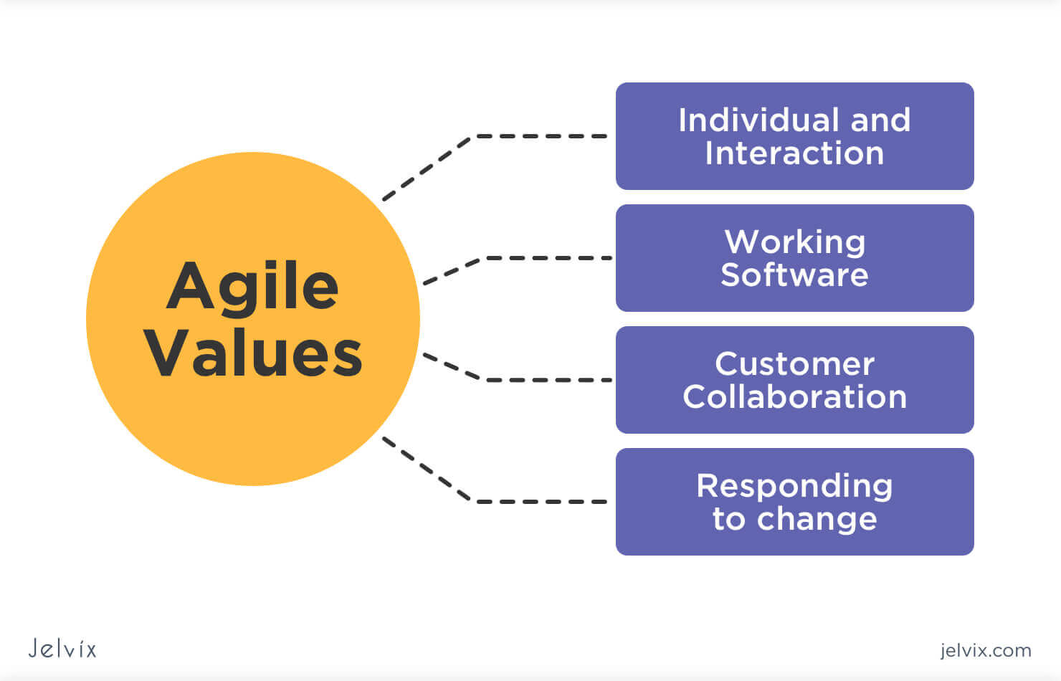
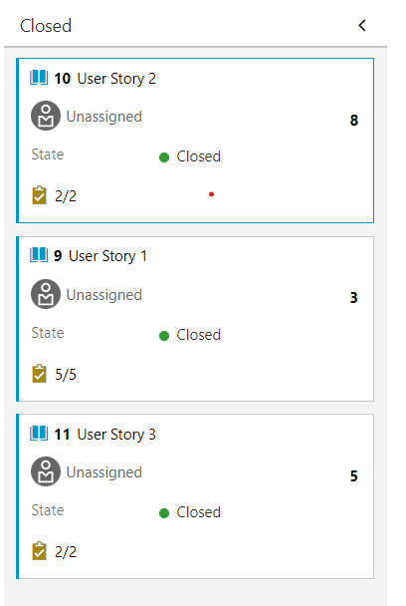
Scrum Board

Slide 6
22nd Aug 2023
Introduction to DBMS
Tasks of a DBMS
Types of DBMS
SQL
Normalization and its Types
Different types of Joins
EXISTS, DISTINCT , etc. Operators
Team Activity – Schema planning

Slide 7
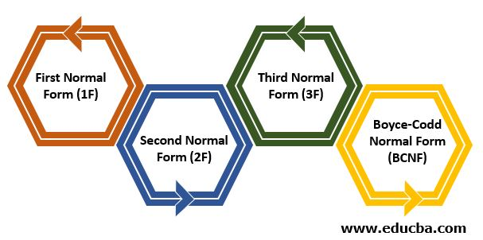
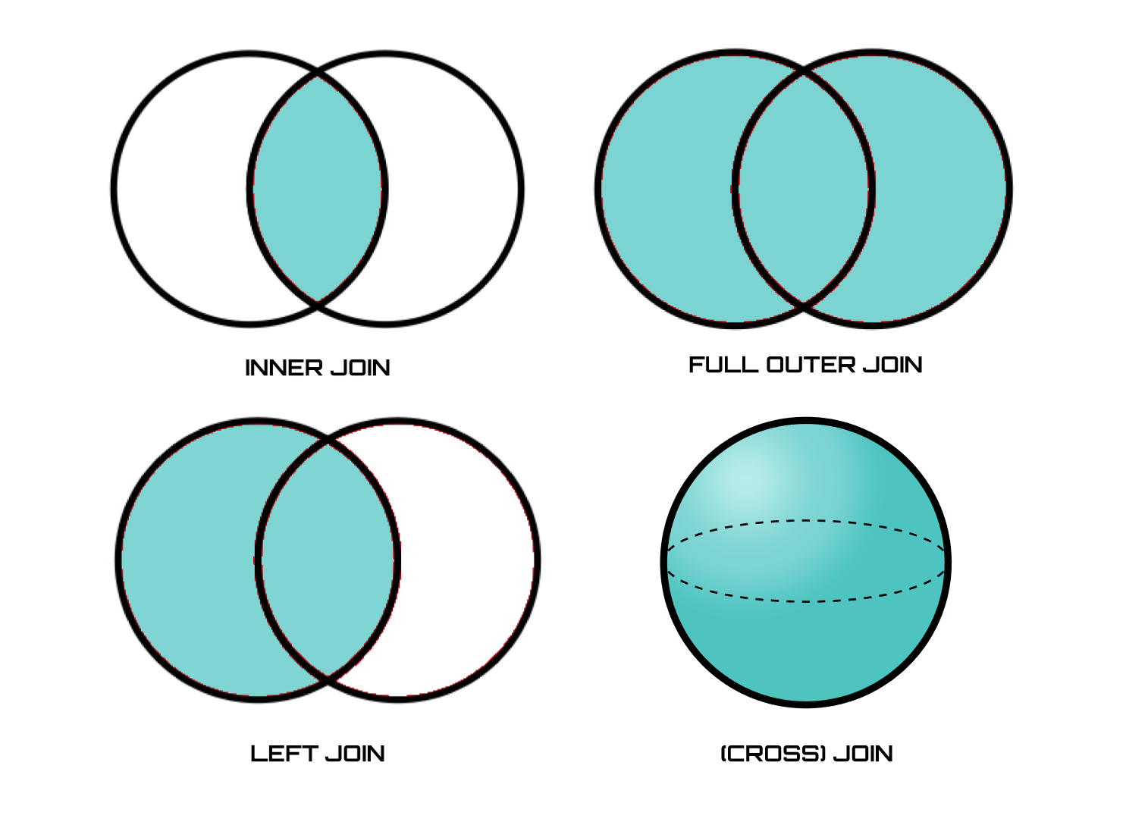
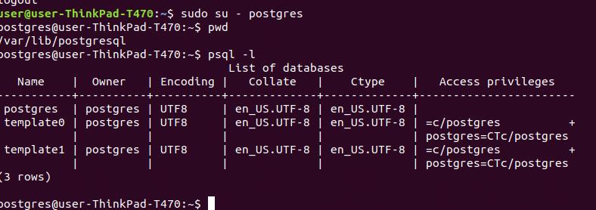

Slide 8
23rd Aug 2023
Introduction to Software Testing
Software Failures
Importance of software testing
Software Test Life Cycle and its phases
STLC vs SDLC
Testing Triangle
Types of Software Testing
Test Driven Development

Slide 9
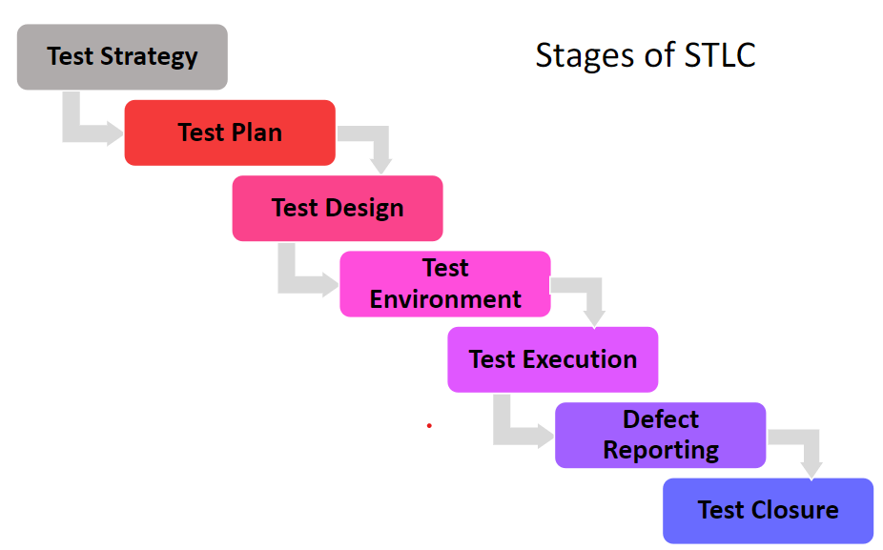

Slide 10
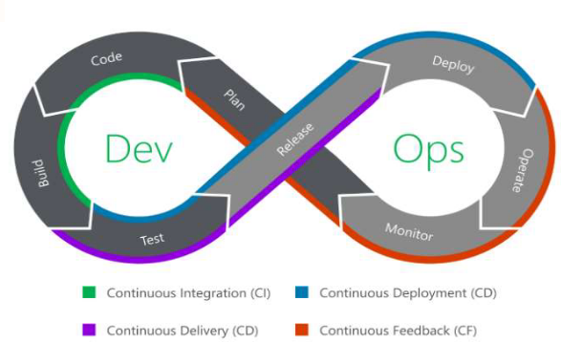
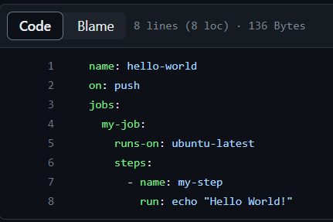
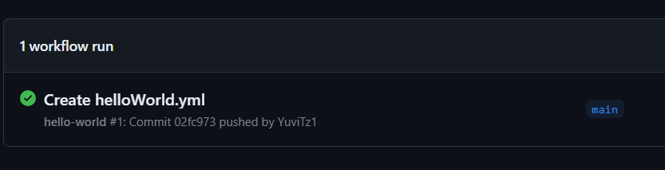
GitHub Actions Workflow

Slide 11
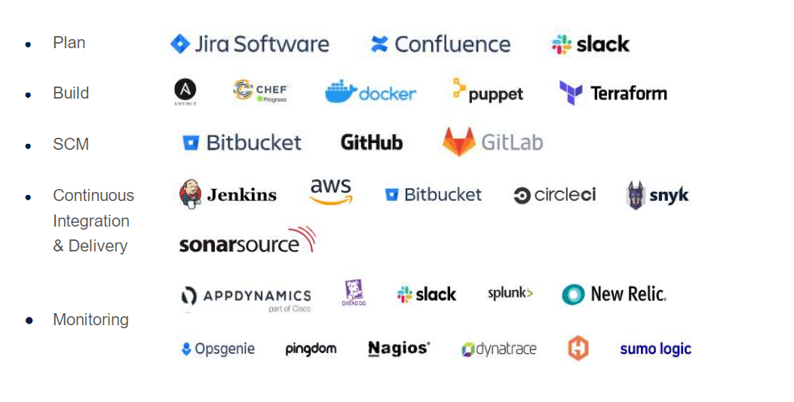

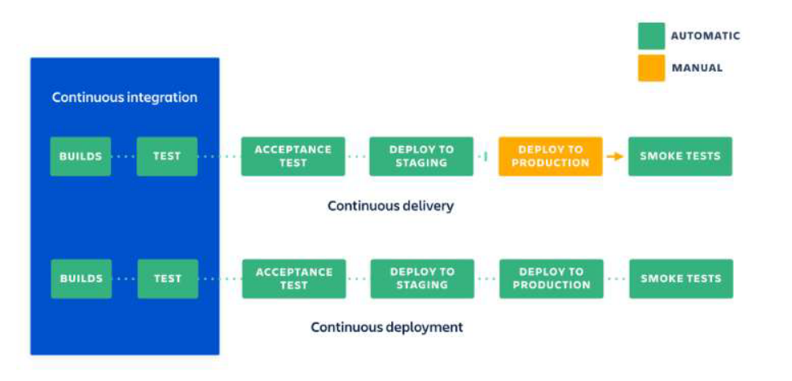

Slide 12
25th Aug 2023
Introduction to Cloud Computing
Cloud services Models
Software as a service
Platform as a service
Infrastructure as a service
Cloud Computing Service layers
Virtualization
Microsoft Azure virtual machines
Cloud Sourcing
Cloud Storage
Advantages/Disadvantages of cloud computing

Slide 13
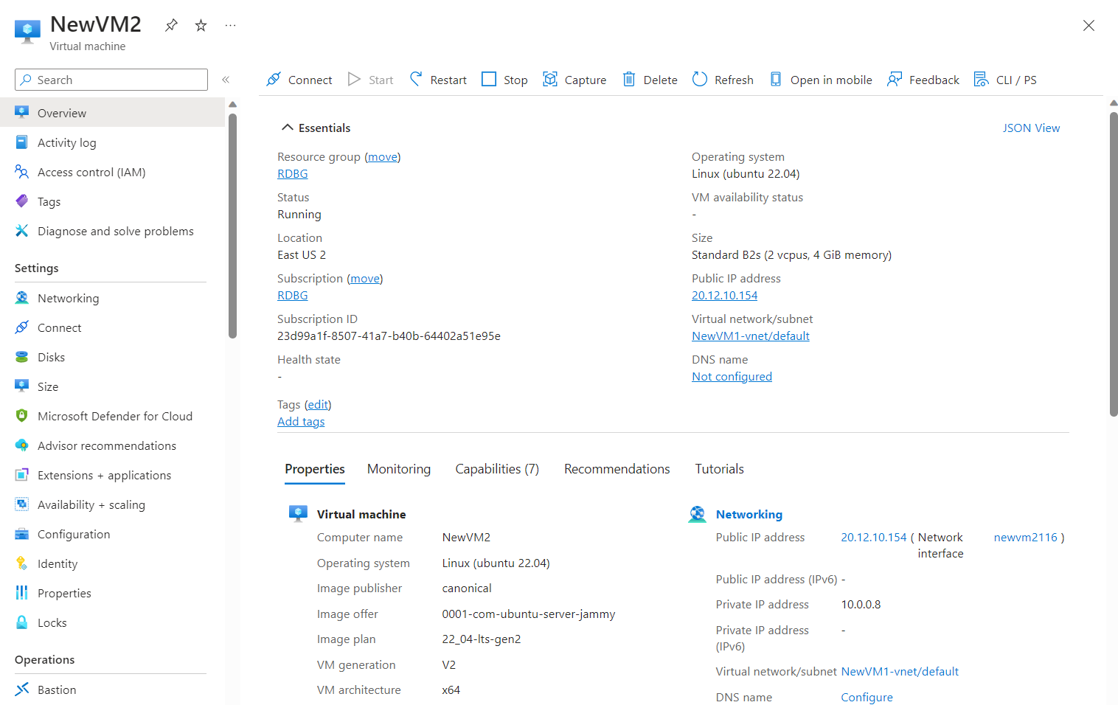
Virtual Machine on Azure

Slide 14
28th Aug 2023
Foundational Bootcamp Final case study
Problem Statement - Implementing a Seamless CI/CD Workflow for a Spring Boot Application using Azure Boards, Azure, Git, Maven, Docker, Github, Github Action

Slide 15
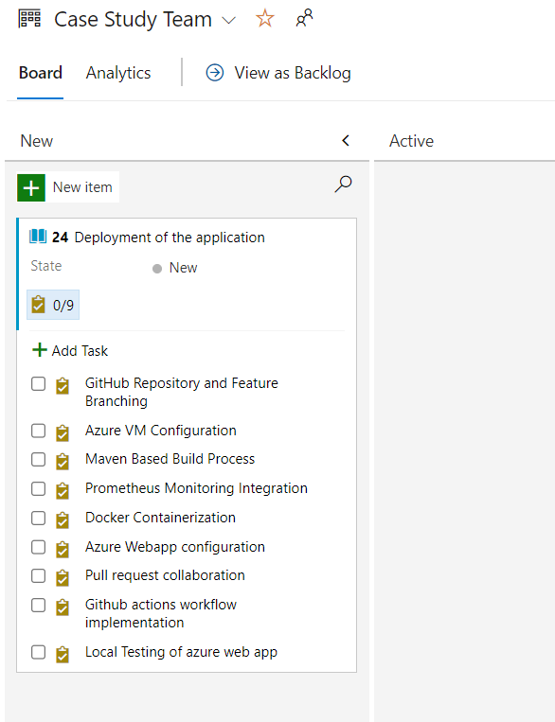
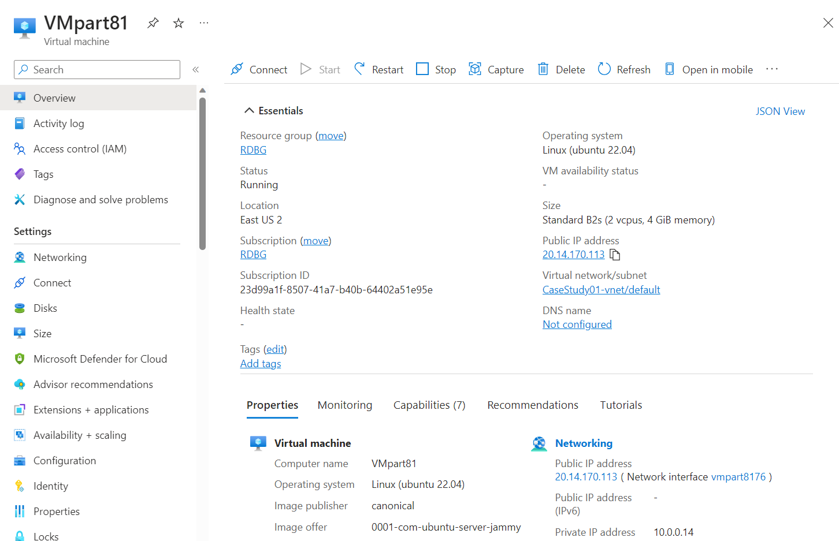
Project Management
Creating Azure VM

Slide 16
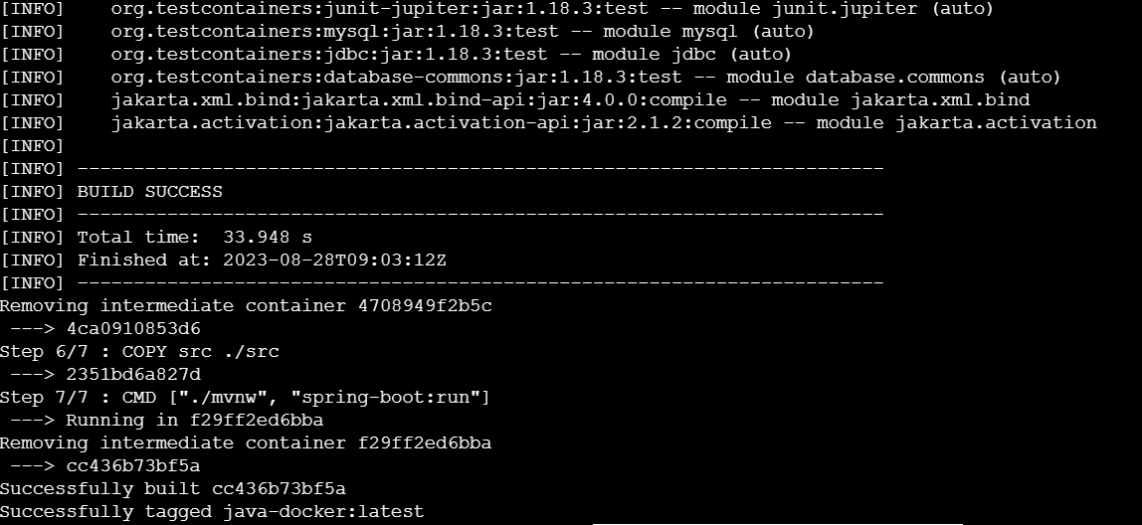
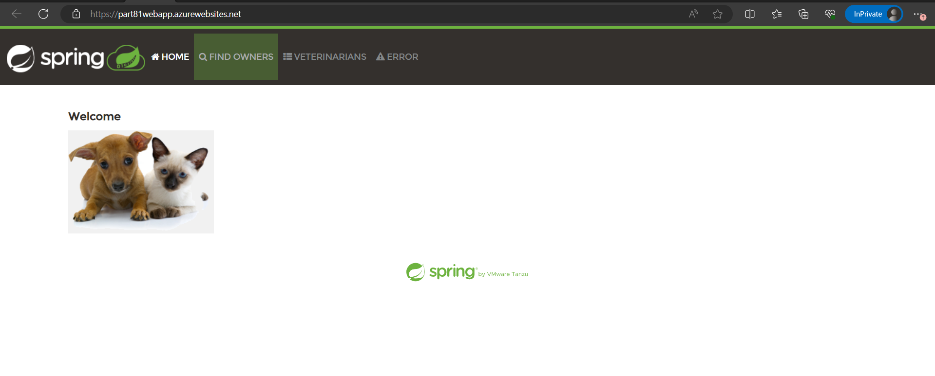
Docker Images
Deployed Web App

Slide 17
29th Aug 2023
Data and Databases
ER Diagram
Normalization
Denormalization
Case study on ER Diagram
Dimension Modelling
SCD

Slide 18
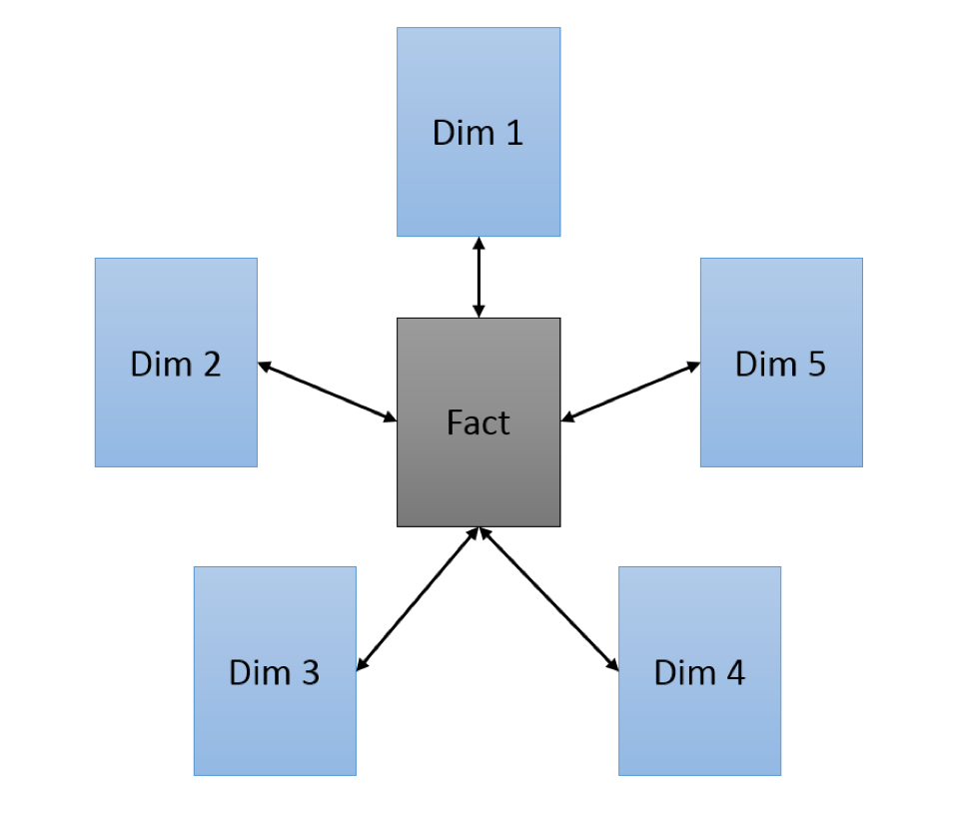
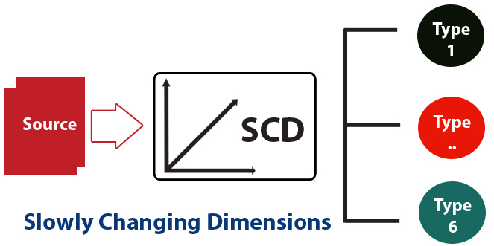
Dimension Modelling

Slide 19
30th Aug 2023
Overview of Big Data
4V’s of Big Data
Volume
Variety
Velocity
Veracity
Batch Processing
Stream Processing
Big data frameworks - spark, Hadoop
Data Warehouse
Data Lake
Cloud Computing Basics
Operational and Capital Expenditure
Azure Fundamentals

Slide 20
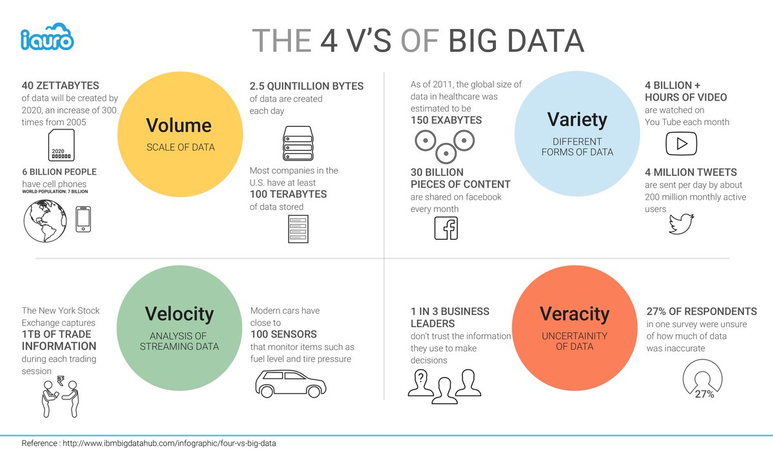

Slide 21
31st Aug 2023
Azure SQL
Types of resources
Single DB, Elastic DB
Configuring azure SQL database and server
getDate()
Views and schemas
Drop, truncate and delete commands
Altering tables
Key constraints

Slide 22
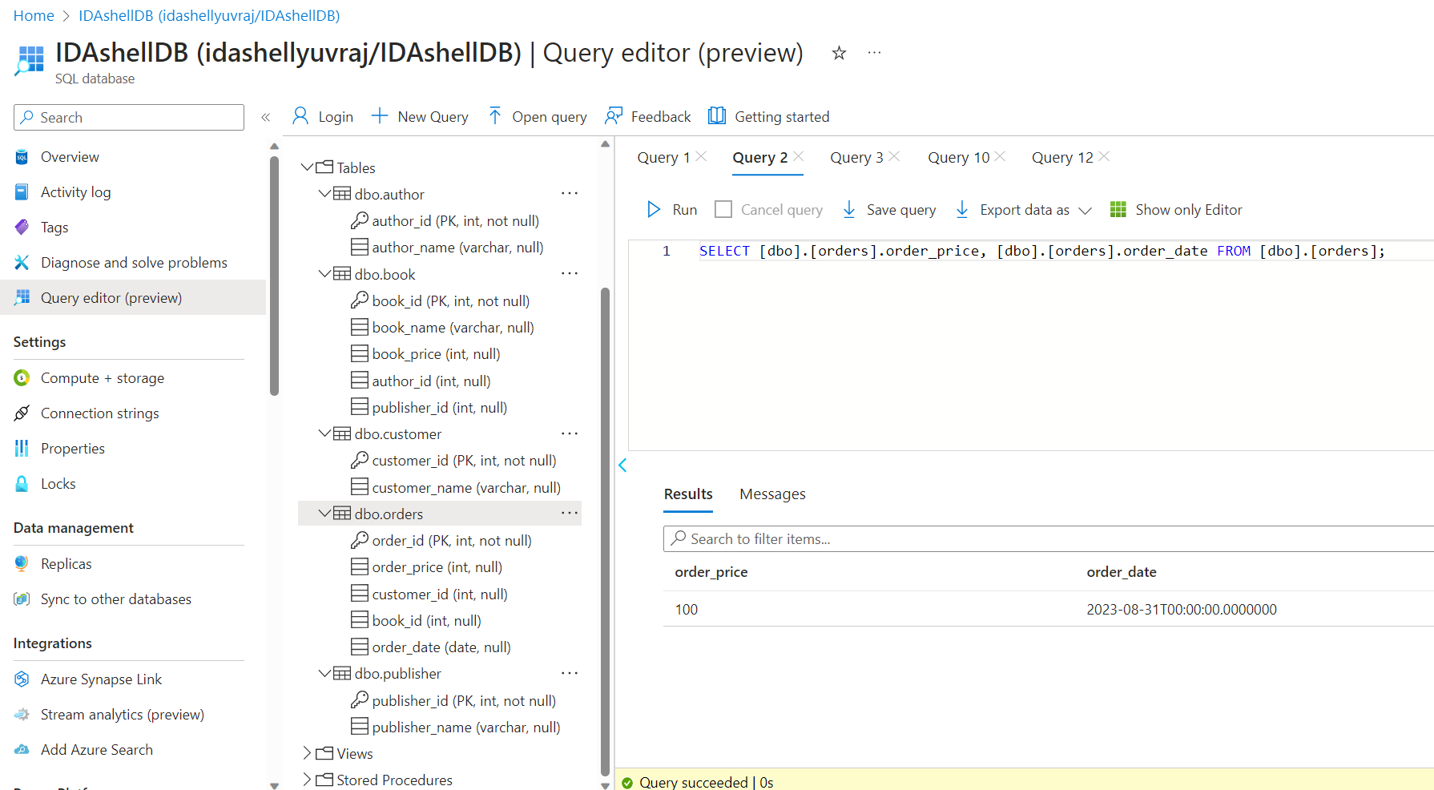

Slide 23
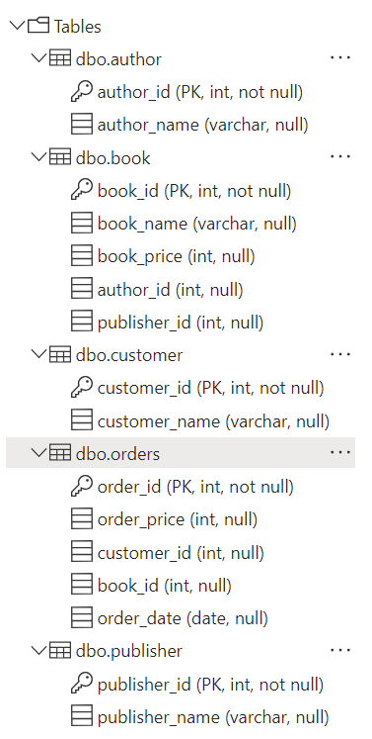
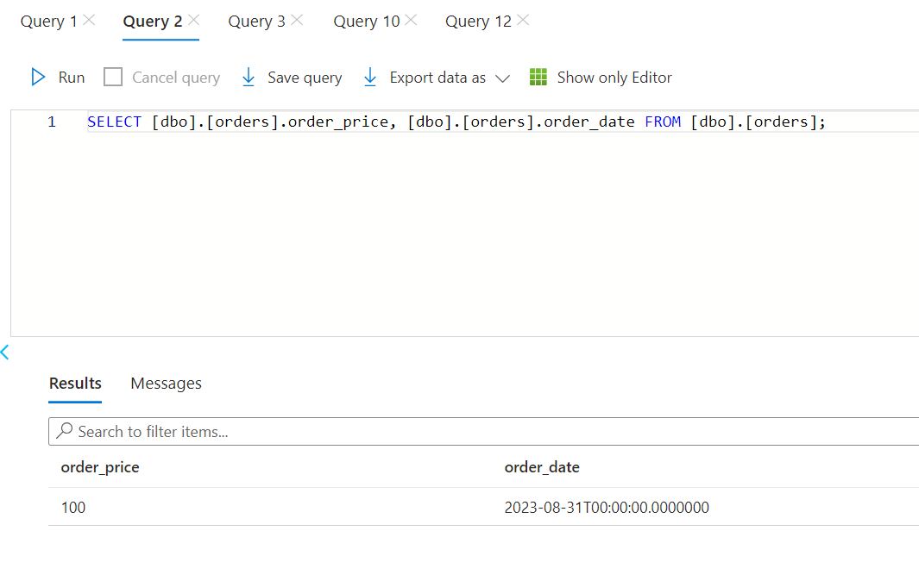
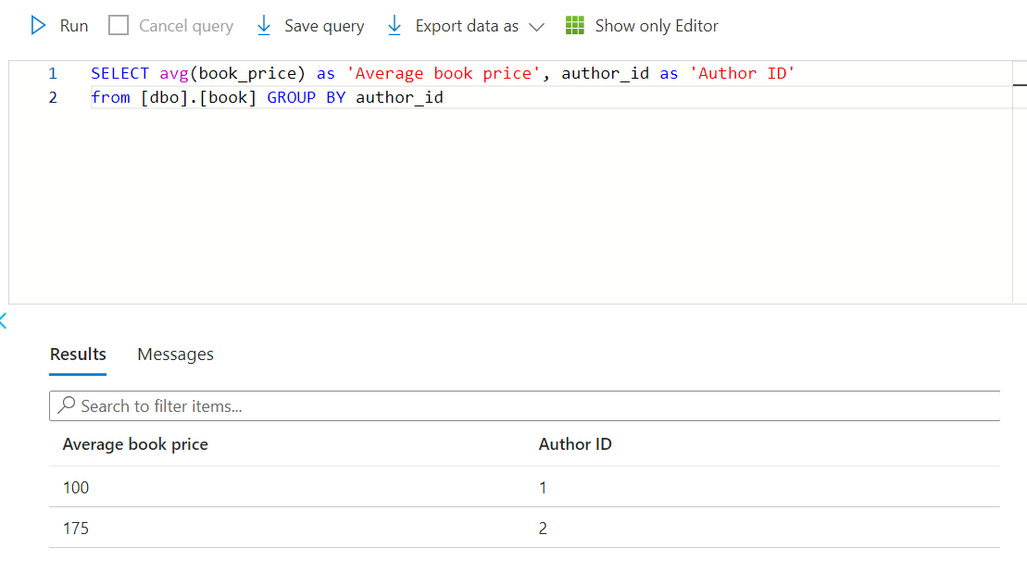
Database tables

Slide 24
1st Sep 2023
Elastic Pool
Subqueries
Self Join, Cross Join
Stored Procedures
Views
Functions
Scalar Functions
Table valued Functions
Temp Tables
Union, Intersection, Union All
Indexing

Slide 25
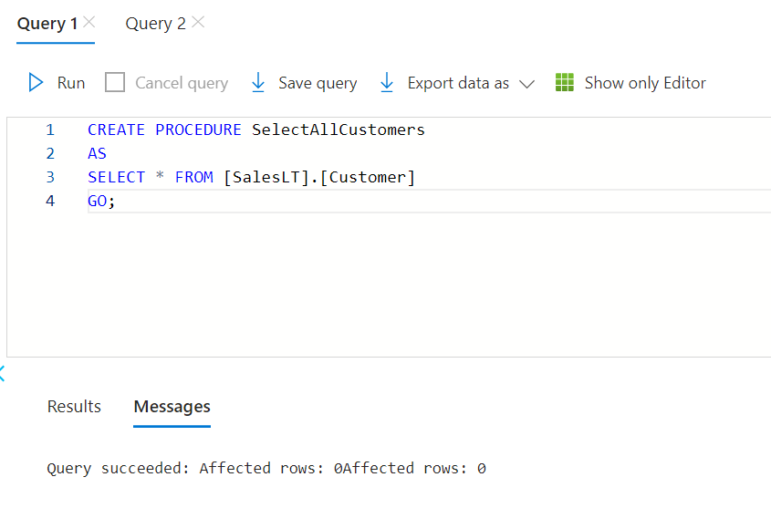
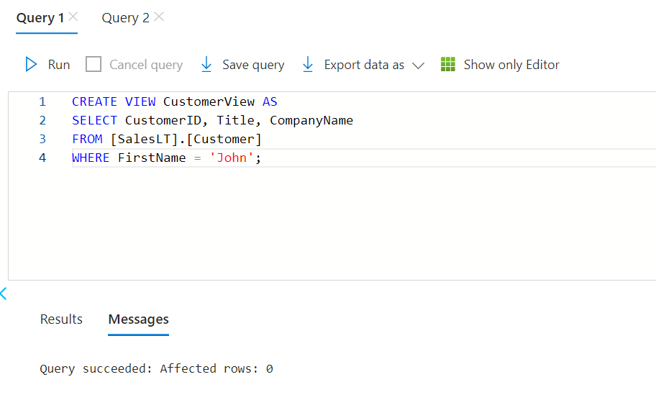
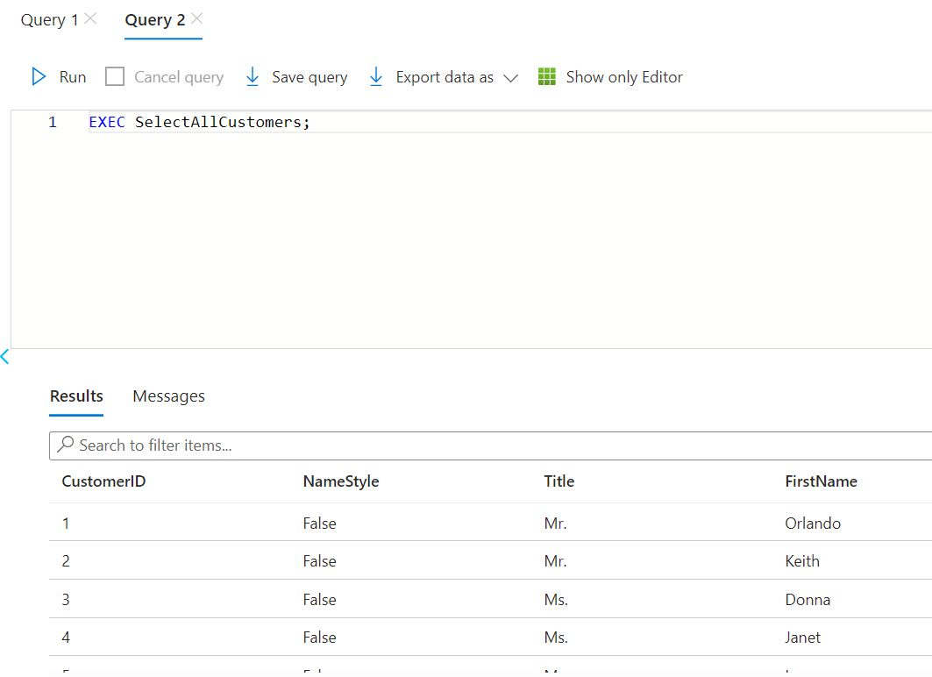
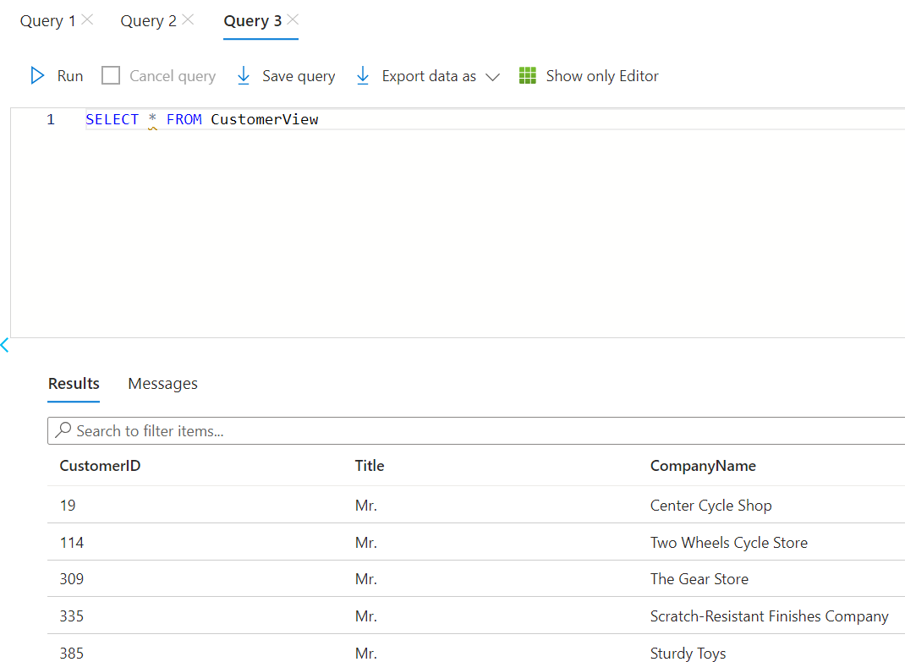

Slide 26
